Slide 1


VR Adventure Game
Part 1: Getting to know VR

Slide 2
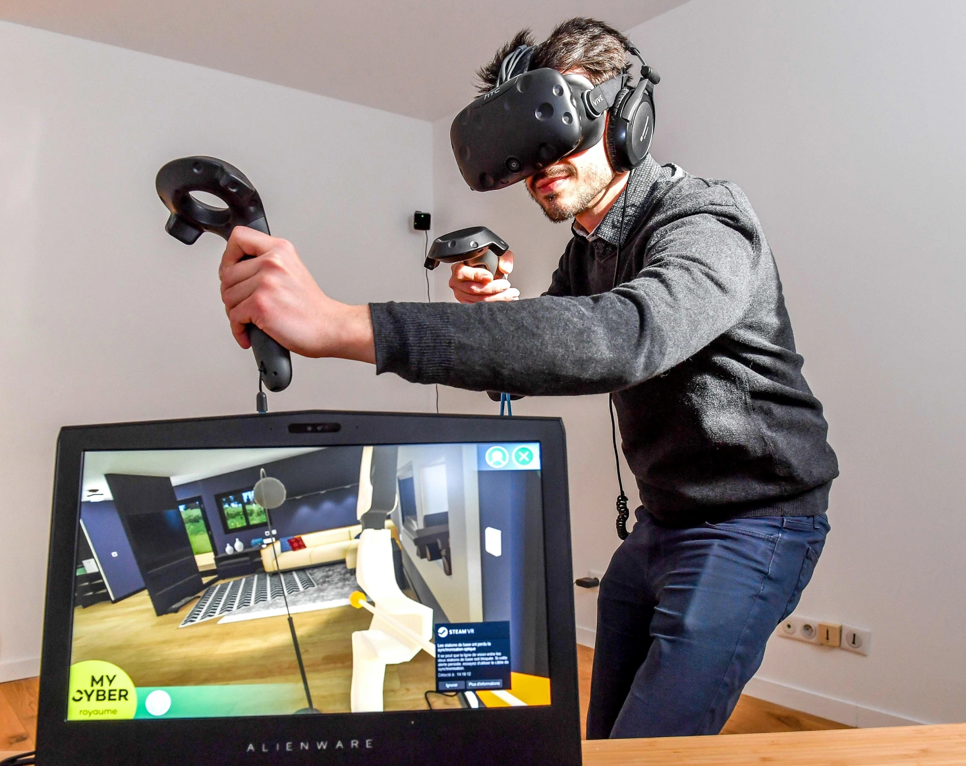
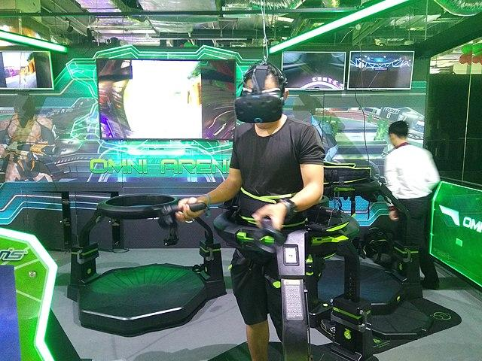
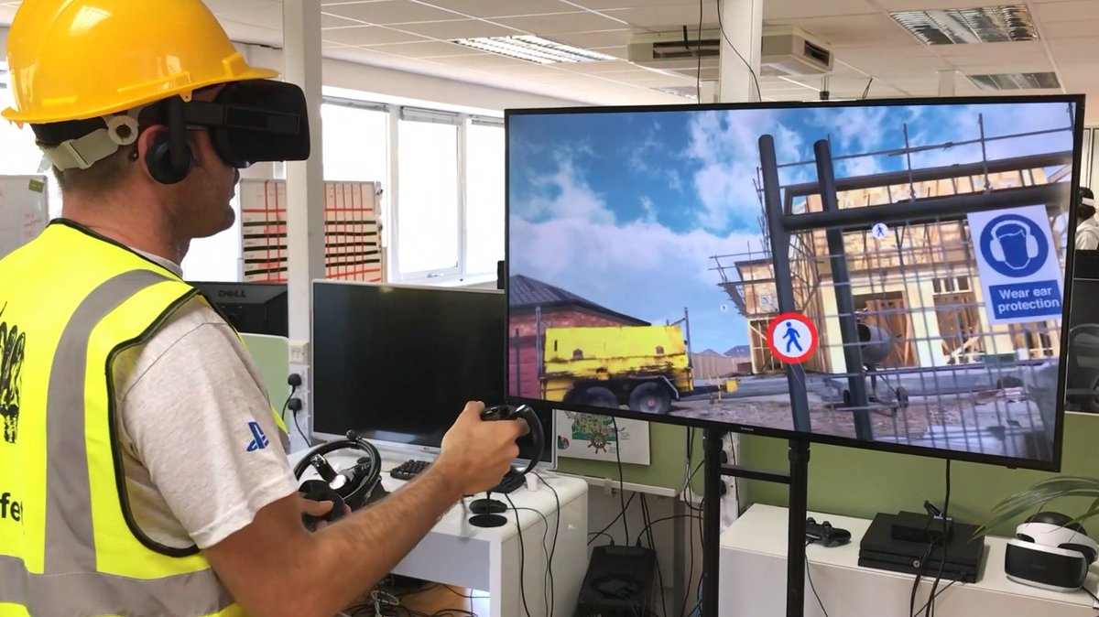
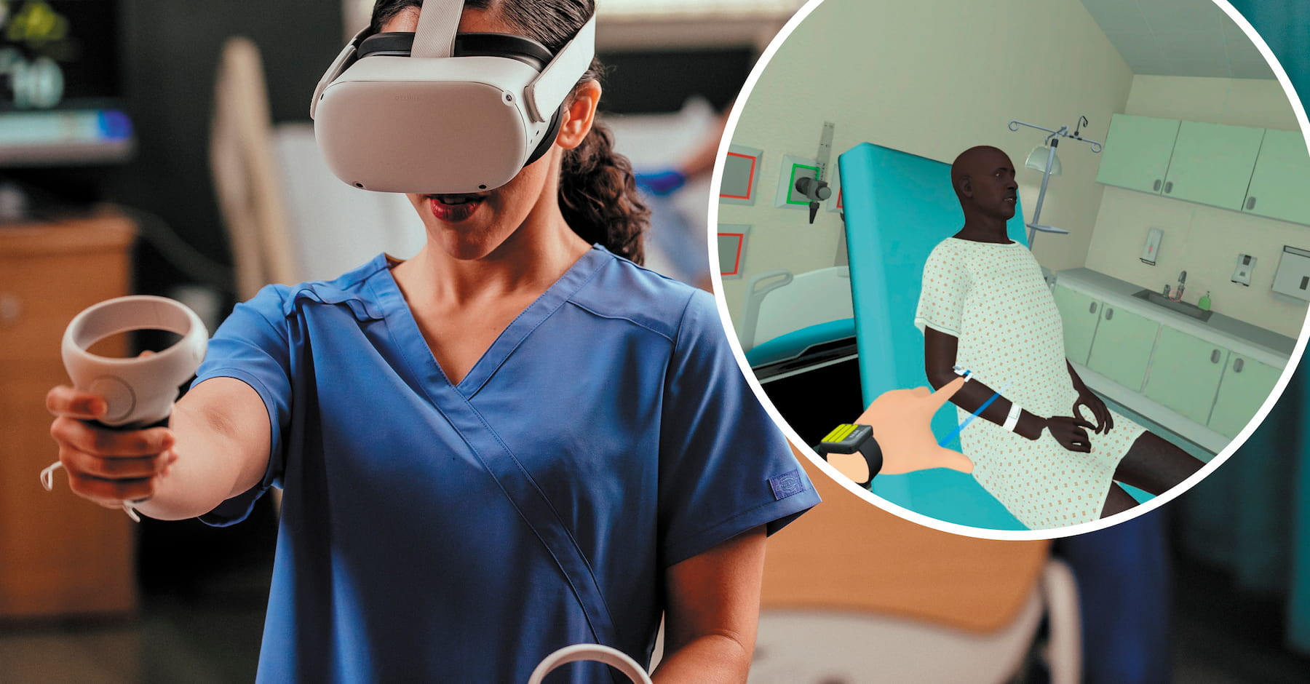
Think Pair Share- How is virtual reality useful in the workplace?
Notes:
Go beyond VR gaming, how can it be useful in other industries?

Slide 3
Lesson objectives:
To be able to add objects and environment to VR
To be able to add animations to objects to VR
To able to add action code (information panel)
To be able to apply transform code to objects

Slide 4
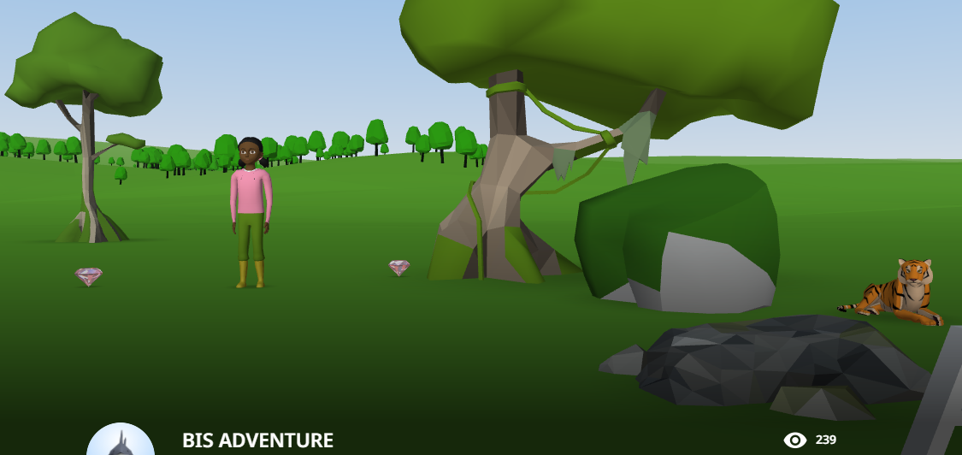
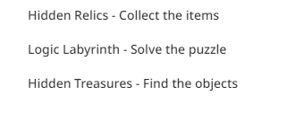
Play the example VR environment
Success Criteria
Explore environment (Arrow keys)
Find any instructions
Complete tasks
Notes:
https://edu.cospaces.io/NTY-BCU
Deploy Via Google Classroom -

Slide 5
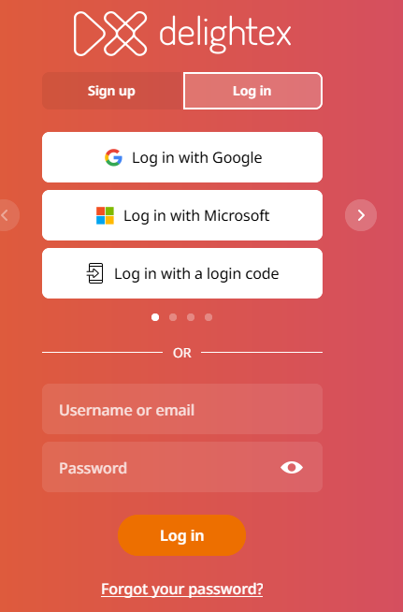
How to LOG IN to Delightex
BISdevice1
BIS123456

Slide 6
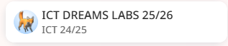
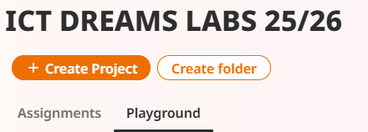
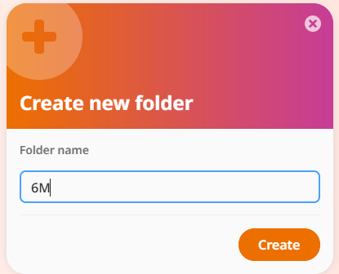
Create your own folder!
Name the folder with your class only

Slide 7
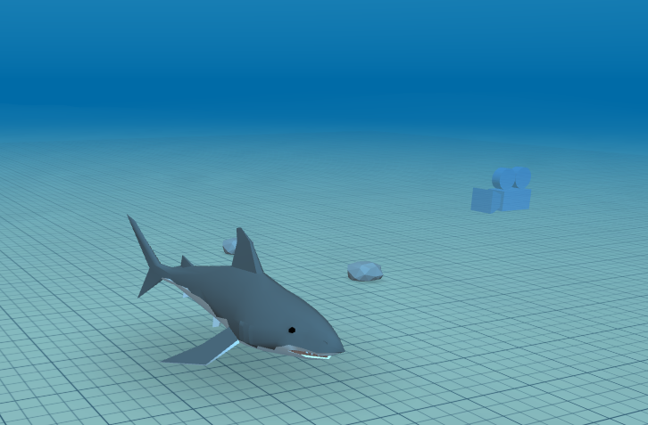
Create your own underwater VR environment
Checklist
Underwater environment
1 sea creature
Two scenery objects
Sea creature animated
Sea creature has transformation code
Notes:
Model how to

Slide 8
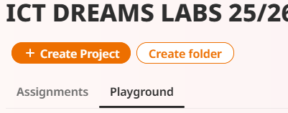
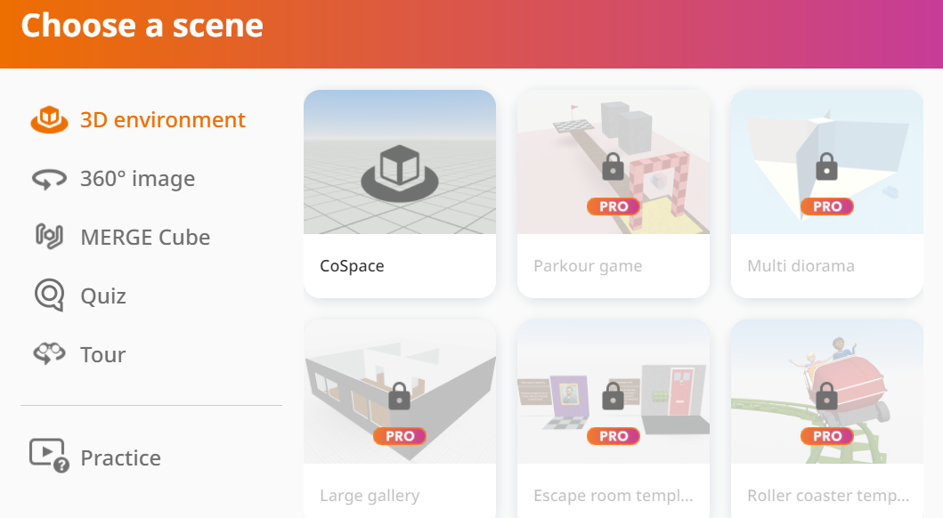
Creating a CoSpace
Inside your folder create your own project
Blank co-space

Slide 9
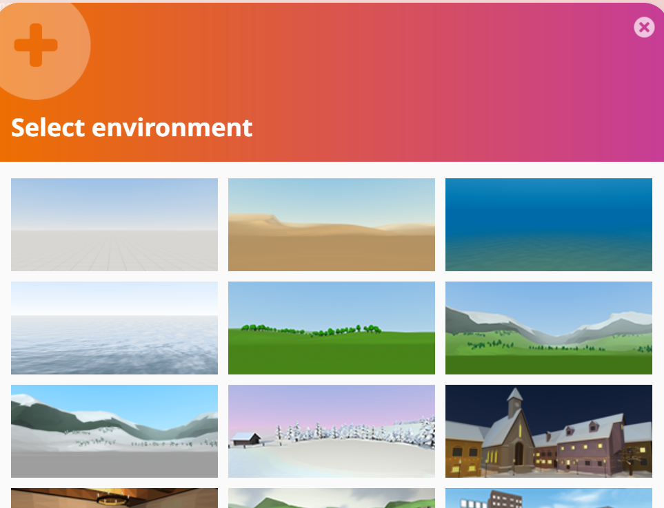
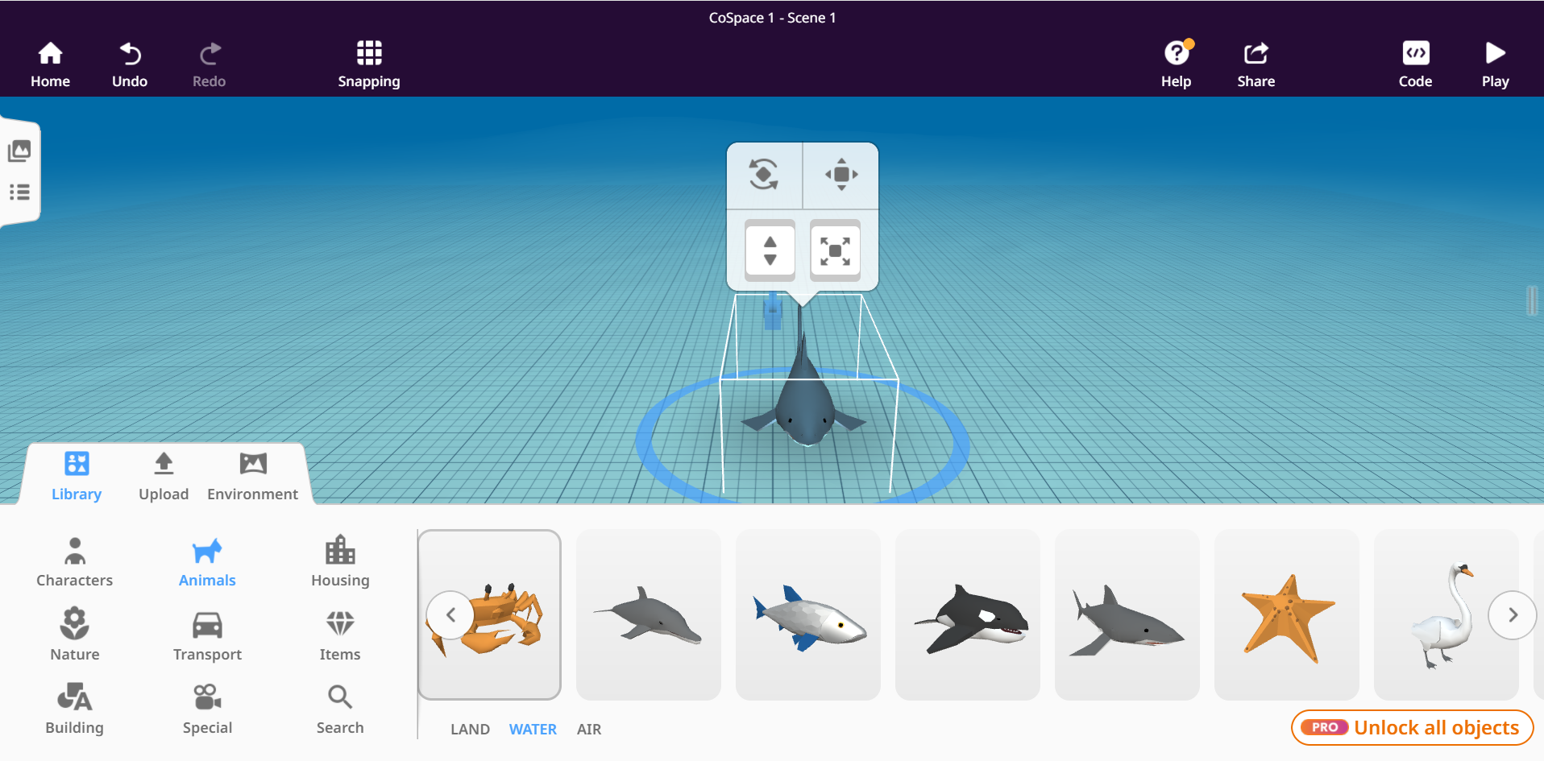
Adding environment & objects
Select underwater environment from library
Choose sea creature

Slide 10
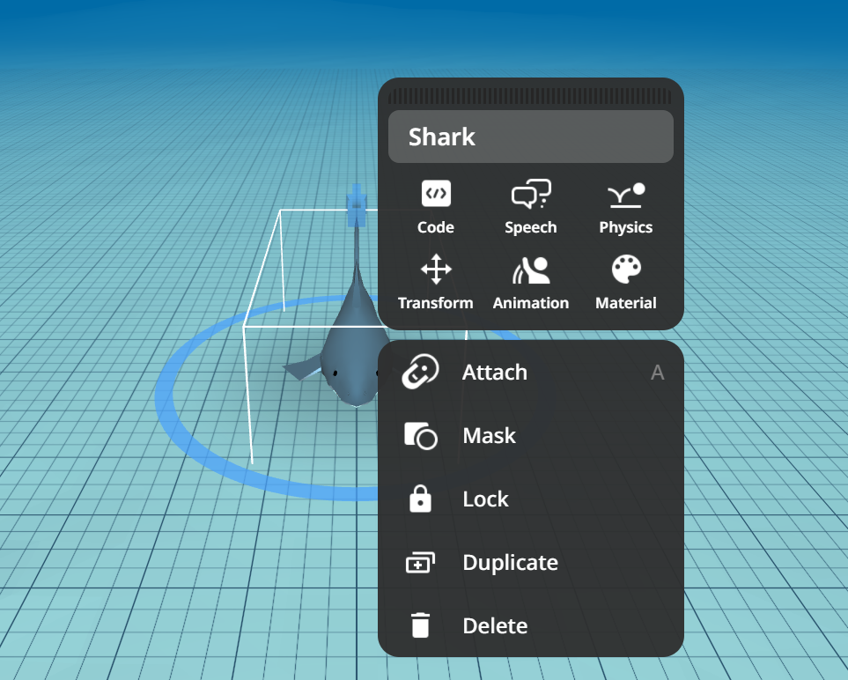
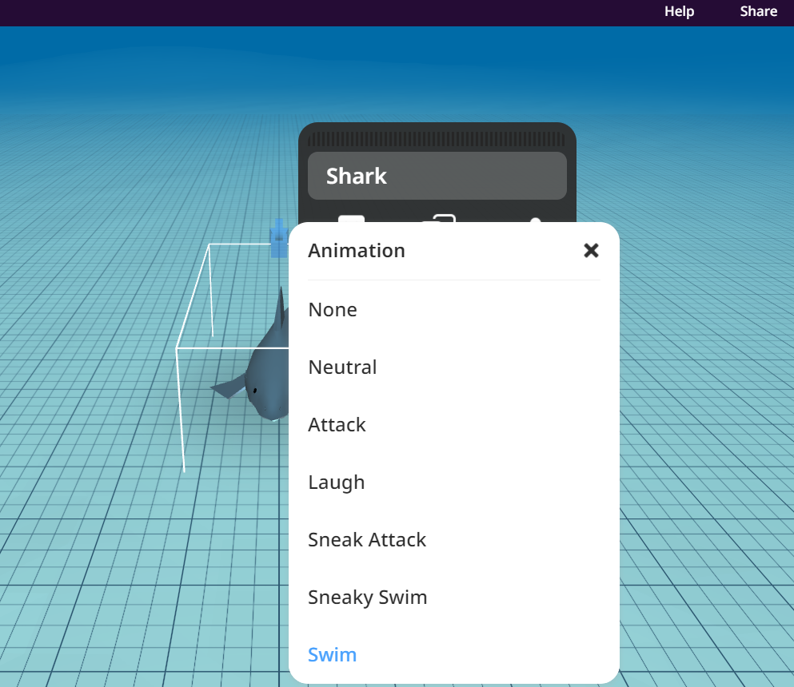
Animations
Right click and apply animation (This is NOT coding)
Select an animation for sea creature

Slide 11
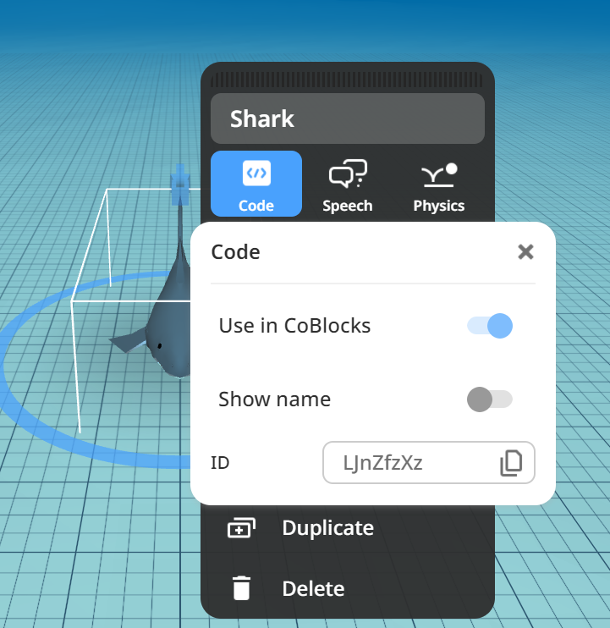

Coding
Select code and code with BLOCKS
Go to the code tab

Slide 12
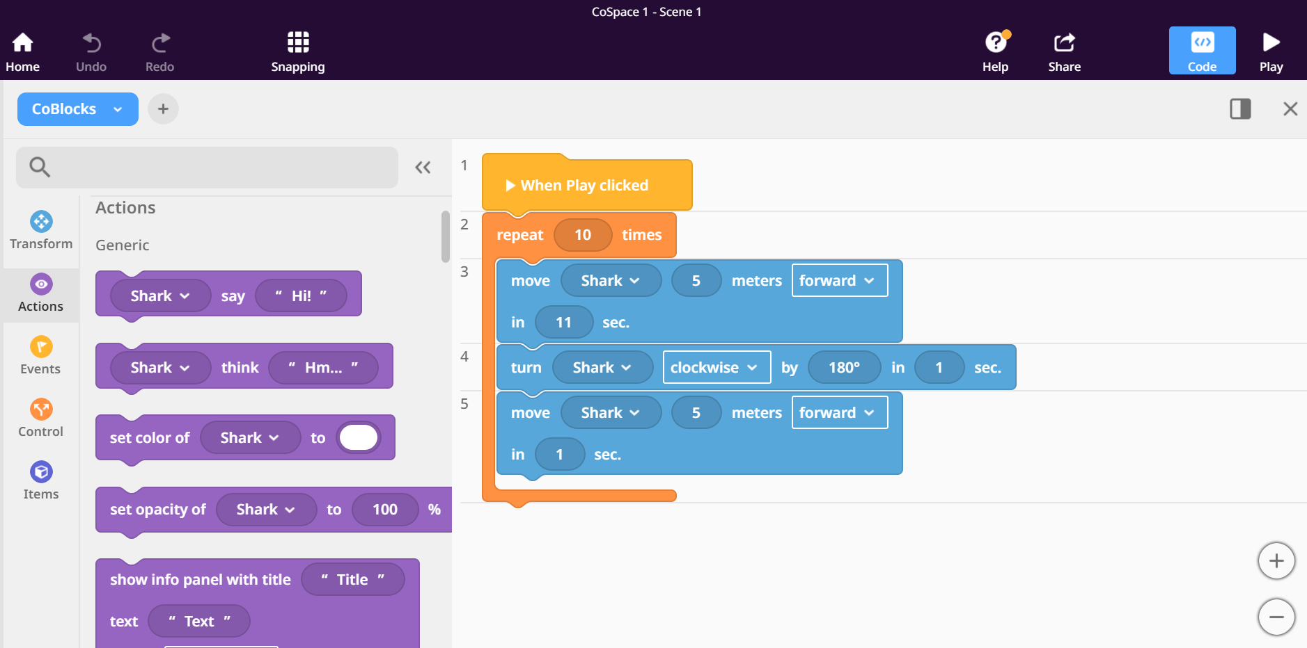
Coding panel and run (play) button
Code block library

Slide 13
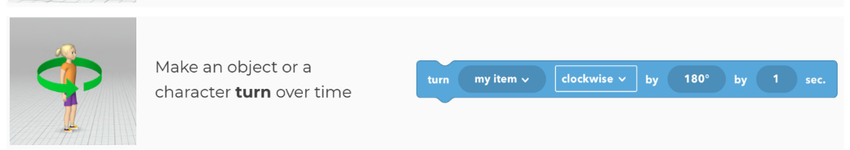
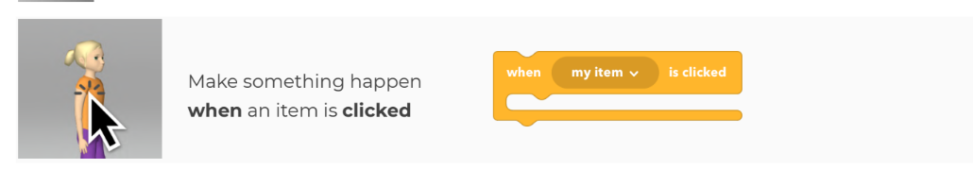
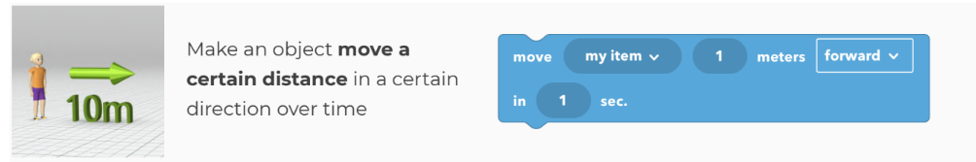
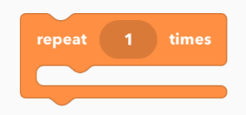
Coding challenge
Combine the different blocks to make the sea creature perform the following task:
Move forward 5 meters for 2 second
Rotate 180 degrees
Move forward 5 meters for 2 seconds
Repeat 10 times

Slide 14
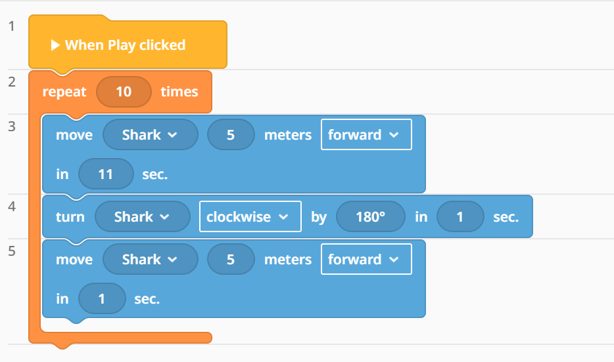
Coding solution

Slide 15
Something not right? Check these first!
Have you enabled code blocks?
Is the camera facing the objects?
Is the camera level with the objects?
Have you named or group objects?
Used the correct event block, ‘When play clicked’?

Slide 16
VR Escape room
Part 2: Coding concepts

Slide 17
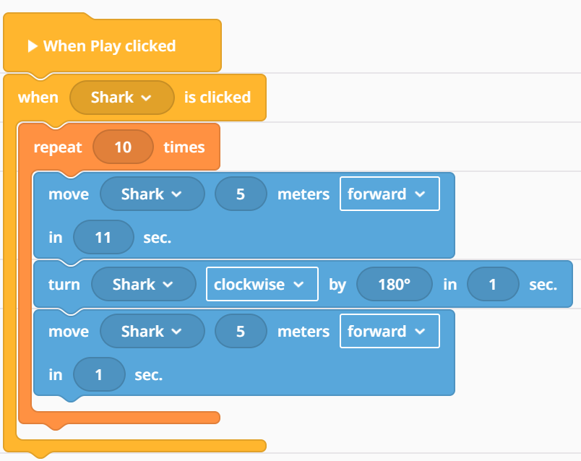
Knowledge retrieval question
When and how will the shark move?
Notes:
AW

Slide 18
Lesson objectives:
Inputs and outputs (Keyboard buttons)
Use and storage of variables (e.g., scores, health, inventory items).
Comparisons and conditions (if, else, nested logic).
Event-driven programming (responding to clicks, collisions, triggers).be able to:
Notes:
AW

Slide 19
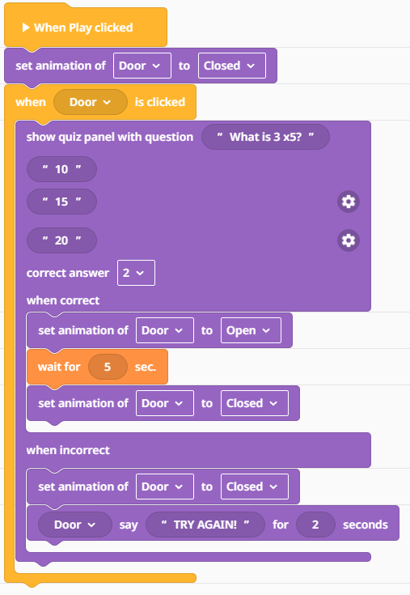
Coding concept: Inputs and triggers
Using the Quiz Panel code block. Create a question where the player must INPUT the correct answer to TRIGGER (start) the door to open.
Notes:
WAGOLL- https://edu.delightex.com/QZZ-DCZ
Deploy this link Via Google Classroom for the template:
https://edu.delightex.com/DSF-FAL

Slide 20
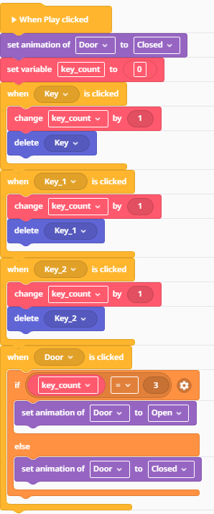
Coding concept: Variables and conditionals
You need to create a VARIABLE called ‘Key Count’.
Using the IF THEN ELSE code block and make the door open when you collect the 3 keys.
Use an OPERATOR to TRIGGER something to happen when key count = 3
Notes:
WAGOLL
Deploy template to Google Classroom: https://edu.delightex.com/CZN-NFU

Slide 21
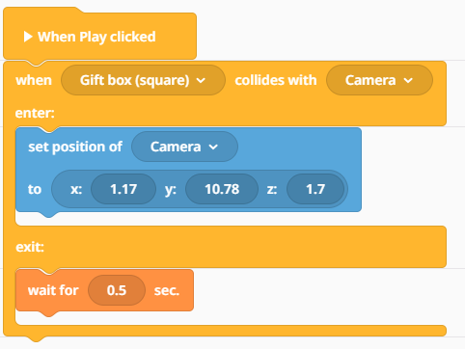
Coding concept: Collision triggers
Code the camera to teleport to new position (XYZ) when it collides with the gift box.
You need to find out the coordinates of the new position and type them into the ‘Set position block’
Notes:
WAGOLL https://edu.delightex.com/ZEC-ZPK
Deploy the template via Google Classroom https://edu.delightex.com/CDY-TMS

Slide 22
Hard thinking question
Statement:
“Variables are not really needed in an escape room game, because you can just use objects and doors to show if something is unlocked.”
Prompt:
Do you agree or disagree? Explain your answer with an example from your project.
Notes:
AW

Slide 23
VR Adventure Game
Part 3: Building your escape room

Slide 24
Knowledge retrieval question
Why are there 3 sets of coordinates in the transformation block (blue)?
Notes:
AW

Slide 25
Design Brief
You must design a Digital Citizenship themed escape room. You must have a minimum of 3 locked doors/ puzzles to solve using the coding concepts from last lesson. Modify the template provided. Try to make it as unique as possible, try to test your imagination!
Notes:
AW

Slide 26
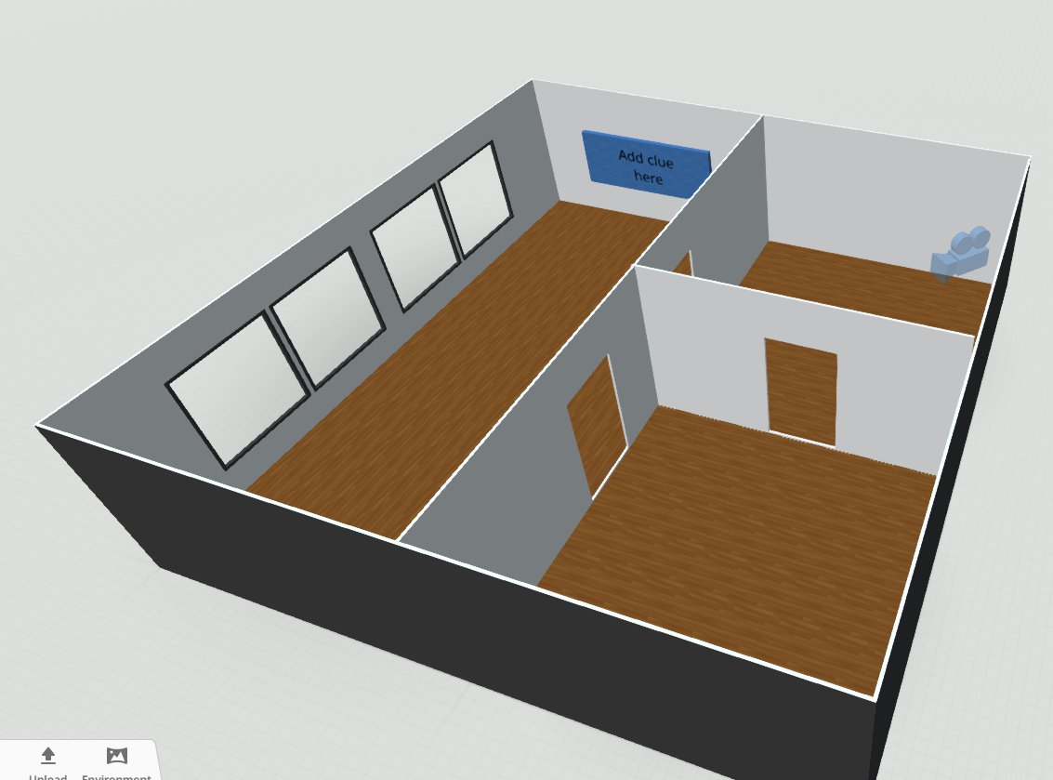
Design Brief
You must design a themed escape room. You must have a minimum of 3 locked doors/ puzzles to solve using the coding concepts from previous lessons. Modify the template provided. Try to make it as unique as possible, try to test your imagination!
Notes:
AW

Slide 27
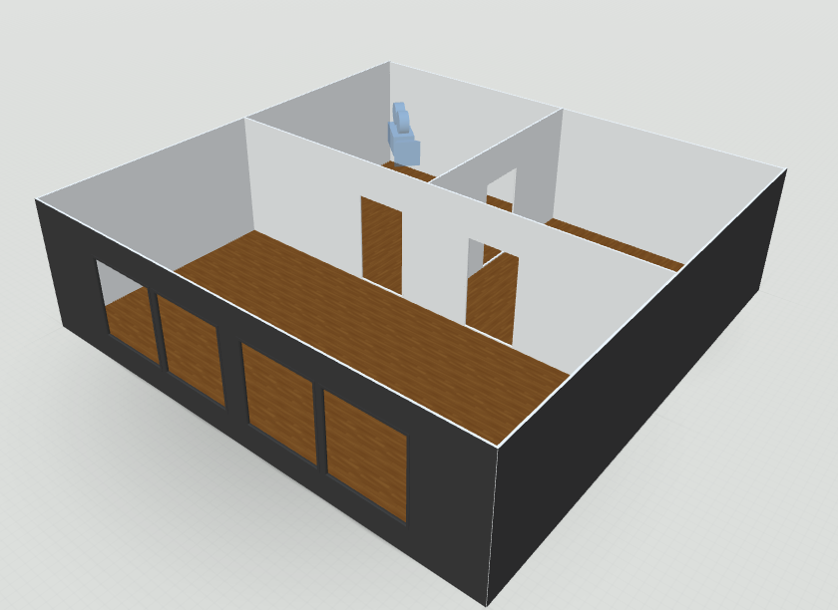
Escape room template
Make copy/ remix of the template. Use keyboard shortcuts to copy elements to make your escape room unique.
Notes:
You will need to live model how you take a fact from the shared doc and how to turn it into a puzzle in the escape room.
Deploy the template via G-Classroom
https://edu.delightex.com/NTH-WZW
DigCit Fact sheets and video link: https://docs.google.com/document/d/1oj8HK9cDIZ3ix2Srl7ITq803YVfas-jB0pkH5Ov0AiM/edit?usp=sharing

Slide 28


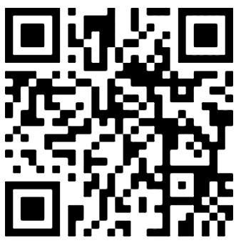
Code Coach
If you’re stuck and your friends don’t know how to create or code something in Delightex. Then ask the Code Coach (AI) for support.
Notes:
Magic School student link: https://student.magicschool.ai/s/join?joinCode=ZEgLiQ

Slide 29
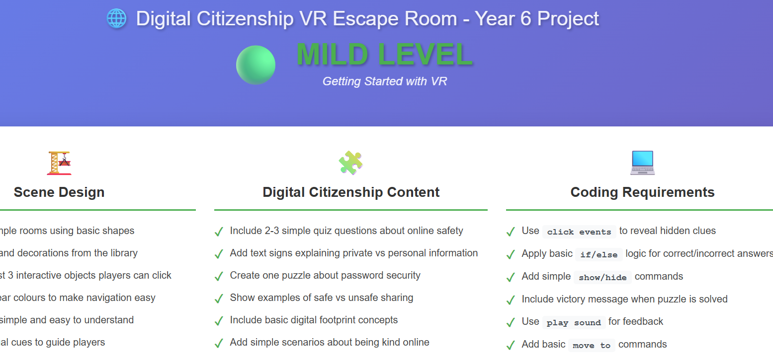
Design Checklist
Take a design checklist and aim to complete the tasks from the list. Mild, medium and spicy- which takes your fancy?
Notes:
Differentiation checklist: https://claude.ai/public/artifacts/c7b6bc03-ecb4-4496-bfc1-18fa5fd8991f

Slide 30
VR Adventure Game
Part 3: Evaluating and modifying

Slide 31
Lesson objectives:
To be able debug a program
To be able to evaluate and modify a program
To be able to give feedback

Slide 32
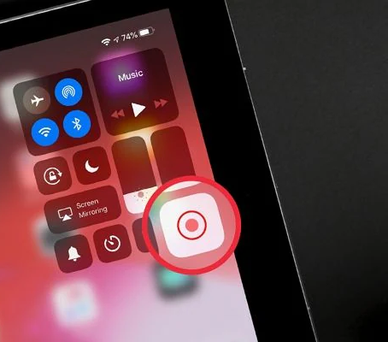
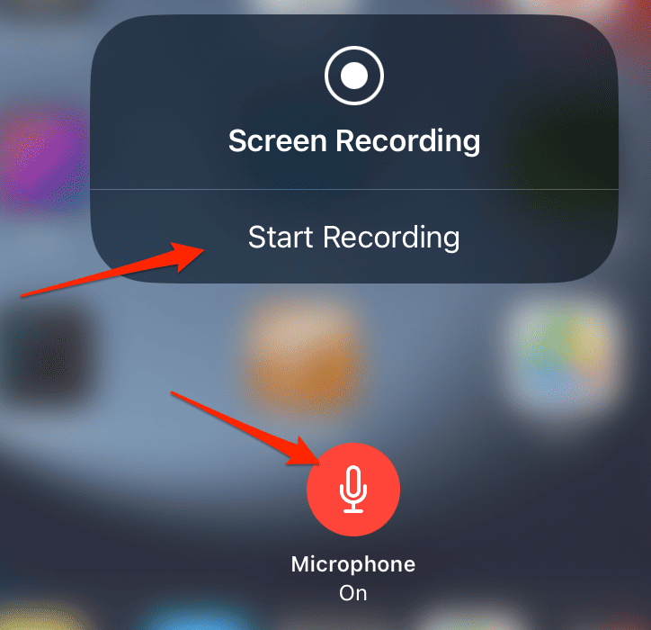
Screen recording tour of your VR
Screen record yourself playing your VR environment
Narrate to the viewers what is happening and how things are coded to work
Edit the video to be 1 min length only.
You can use any video editing app you like
Upload video to seesaw task

Slide 33
End of project POA (Plan of Action!)
Final editing of your project (15mins)
Copy Share the link to Seesaw and complete self assessment sheet (10mins)
Take the Delightex quiz on Google Classroom (10mins)
Play friends escape room and leave TAG Feedback (20mins)

Slide 34
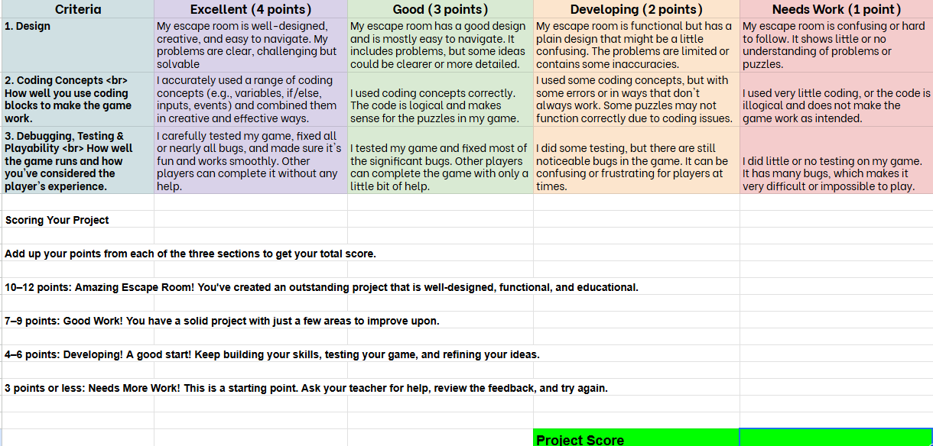
Self Assessment Grid

Slide 35
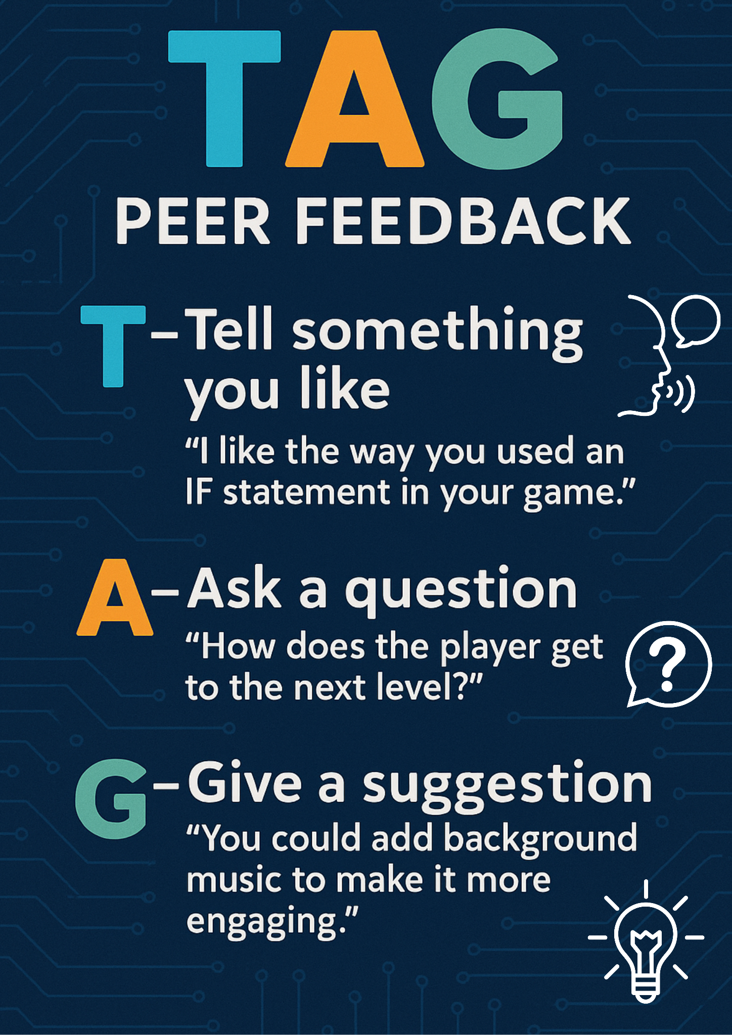
Play a friends escape room and give them some TAG feedback.

Slide 36



Peer testing
Share your game link with a friend
Play your friends escape room and give them TAG feedback on Seesaw
Read the feedback about your escape room, debug and modify your VR
Notes:
https://docs.google.com/spreadsheets/d/1mSqhsn9oO-qqwcCSrEM9BRCuaBhcYJOn6D5dIbo43IE/edit?gid=818209139#gid=818209139
Self assessment link here
Seesaw

Slide 37


Test your CoSpaces knowledge by taking the Quiz on your Google Classroom
Notes:
https://quizizz.com/admin/quiz/66f0b83bd6563e6edb1ca847?source=quiz_share

